Slide 1


Causes of Death Analysis
BY : Mohamed Hatem | Nour Emil | Omar EL Badry

Slide 2
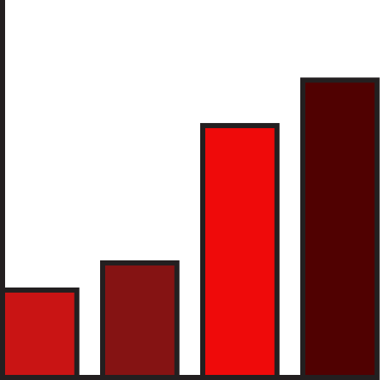

Introduction
Objective: To analyze global death trends over three decades and uncover key insights through a dynamic dashboard.
Scope:
Countries Analyzed: 204
Total Deaths Recorded: 1 billion+
Average Deaths per Country: 7,740
Key Focus: Identifying the major causes of death and their variations across countries.

Slide 3
Methodology
Python
Excel
Power BI
Data loading and discovery
Data Cleaning and Transformation
Create a line chart and heatmap (Bonus) to show the correlation between different causes of death
Create a simple model to predict total deaths in the future (Bonus)
Create multiple informative Pivot Tables
Create informative Visualizations using the data
Created a dashboard with country selection, showing deaths over time and total deaths in the selected country. (Bonus)
Transform data using Power Query to unpivot causes of death and put them into rows instead of columns
Create an interactive dashboard with different charts and slicers to drive informed data-driven decision-making

Slide 4

Global Death Trends
Time Period: 1990-2019
Trend: A steady increase in annual deaths, ranging from 45 to 55 million per year.
Key Question: How have global deaths changed annually from 1990 to 2020?

Slide 5

Top Countries by Deaths
Top 5 Countries:
China: 265 million deaths
India: 238 million deaths
United States: 71 million deaths
Russia: 59 million deaths
Indonesia: 44 million deaths
Insight: Countries with large populations, such as China and India, contributed significantly to global death counts.

Slide 6

Key Analytical Questions
Global comparison of death rates for a specific year.
Total global deaths from 1990 to 2019.
Death trends for a selected country over time.
Top countries for Alzheimer's disease mortality.
Countries with the highest death rates from Meningitis.
A comparison of HIV/AIDS and Tuberculosis deaths globally.
Correlation between Diabetes Mellitus and Cardiovascular Diseases.
How are Nutritional Deficiencies and Protein-Energy Malnutrition related?
Do chronic respiratory disease deaths relate to lower respiratory infection deaths?
Is there a link between death rates from diarrheal diseases and malaria in areas with poor sanitation and healthcare?
In the top 4 countries for alcohol use disorder deaths, do road injuries also account for many deaths?

Slide 7

Leading Causes of Death
Top 5 Causes:
Cardiovascular Diseases
Neoplasms
Chronic Respiratory Diseases
Lower Respiratory Infections
Neonatal Disorders
Insight: Cardiovascular diseases emerged as the leading cause of death globally.

Slide 8

Comparative Insights
HIV/AIDS vs. Tuberculosis: Analyzed death rates from both diseases, highlighting similarities in affected regions.
Diabetes Mellitus and Cardiovascular Diseases: Investigated the correlation between high diabetes rates and cardiovascular-related deaths.
Nutritional Deficiencies and Protein-Energy Malnutrition: Explored their connection in countries with high malnutrition rates.
Alcohol Use Disorders and Cirrhosis: Examined regions with high alcohol-related deaths and their link to liver diseases.
Chronic Respiratory Diseases and Infections: Assessed any relationships between chronic respiratory conditions and lower respiratory infections.
Diarrheal Diseases and Malaria: Compared death rates in regions with poor healthcare infrastructure.

Slide 9

Key Dashboard Insights
Population Size Impact: Larger populations, such as in China and India, naturally correlate with higher death counts.
Developed vs. Developing Nations: Developed and developing nations are prominently in death statistics ex: US and Nigeria.
Non-communicable Diseases (NCDs): NCDs, especially cardiovascular diseases, were the primary causes of death.
Infant Mortality: Neonatal disorders were a major cause of death, particularly in regions with insufficient healthcare.
Environmental Factors: Respiratory diseases suggest an impact from environmental factors like air pollution.

Slide 10

CONCLUSION
Population Size and Mortality: High death counts in populous countries are influenced more by population size than life expectancy.
Life Expectancy in Developed Countries: Higher death counts from age-related diseases in developed nations like the US and Japan indicate longer life expectancies.
Non-Communicable Disease Prevalence: The prominence of NCDs reflects a global shift towards chronic conditions due to increased life expectancy.
Developing Countries and Healthcare: High mortality rates in countries like Nigeria and Pakistan indicate challenges in healthcare infrastructure.
Neonatal Mortality: Addressing neonatal health can significantly improve life expectancy in vulnerable regions

Slide 11
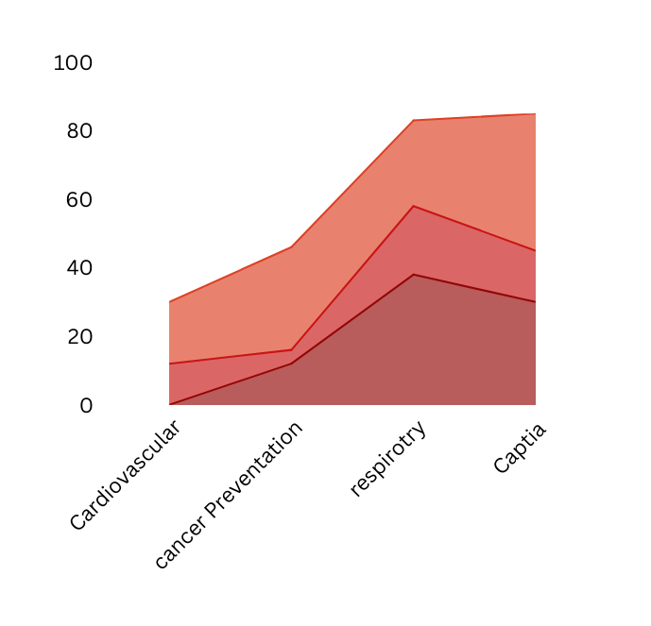
Future Considerations
Healthcare Focus:
Cardiovascular health, cancer prevention, and respiratory care should be
prioritized to reduce global mortality rates.
Economic and Environmental Impact:
Improving healthcare systems and addressing environmental challenges
(like air quality) could further boost life expectancy.
Per Capita Death Rates:
Future analysis should focus on per capita death rates for more accurate cross-
country comparisons.

Slide 12
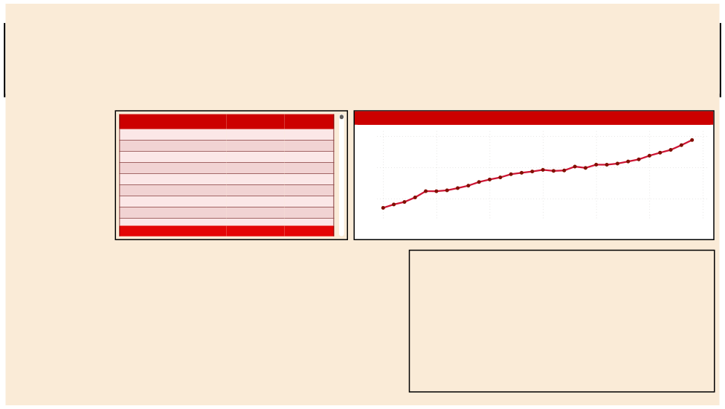
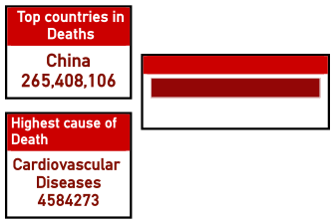



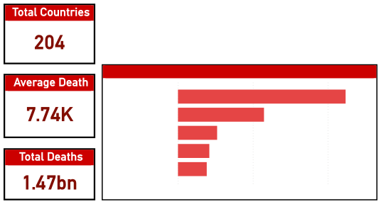
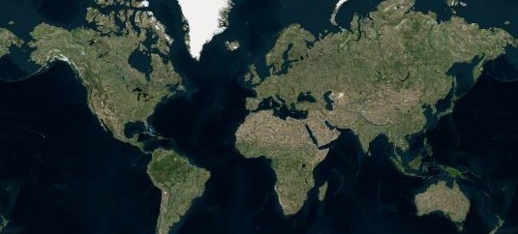
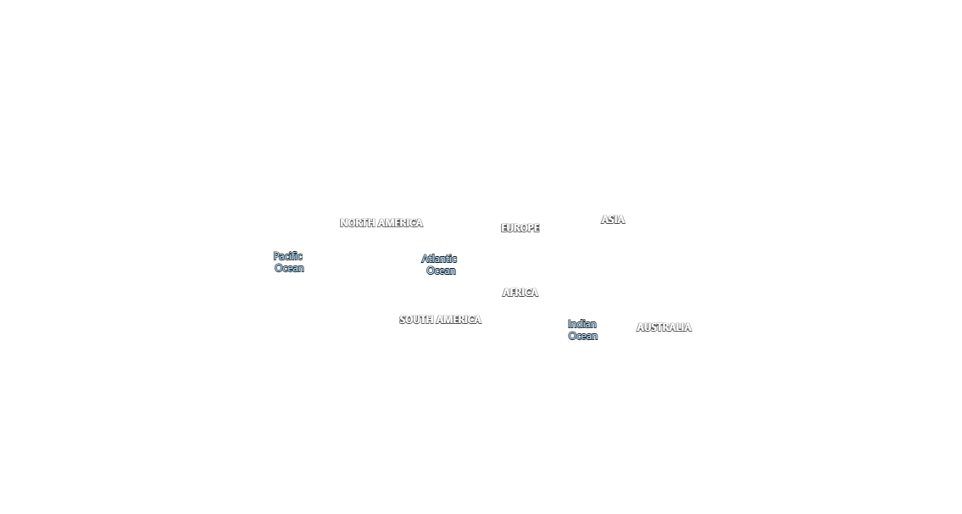
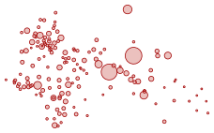

Causes Of Death Dashboard
country/Territory
Years
causes of Death
All

All

1990
2019
Countr y/Territor y Afghanistan
Albania
Algeria
American Samoa
Andorra
Angola
Antigua and Barbuda
Argentina
Total
Cause of death

Tuberculosis
Tuberculosis
Tuberculosis
Tuberculosis
Tuberculosis
Tuberculosis
Tuberculosis
Tuberculosis
Total deaths
Number of deaths by Years
147637
593
18089
30
0
473636
11
30389
1468134716
55M
50M
45M
1990
1995
2000
2005
Year
2010
2015
2020
Top 5 Cause of Deaths
Cardiovascular Dis…
Neoplasms
Chronic Respirator…
Lower Respiratory…
Neonatal Disorders
0.0bn
0.2bn
0.4bn
© 2024 TomTom,, Earrtthsttarr Geogrraphiics SIIO,, © 2024 Miicrrosofftt Corrporrattiion,, © OpenSttrreettMap

Slide 13
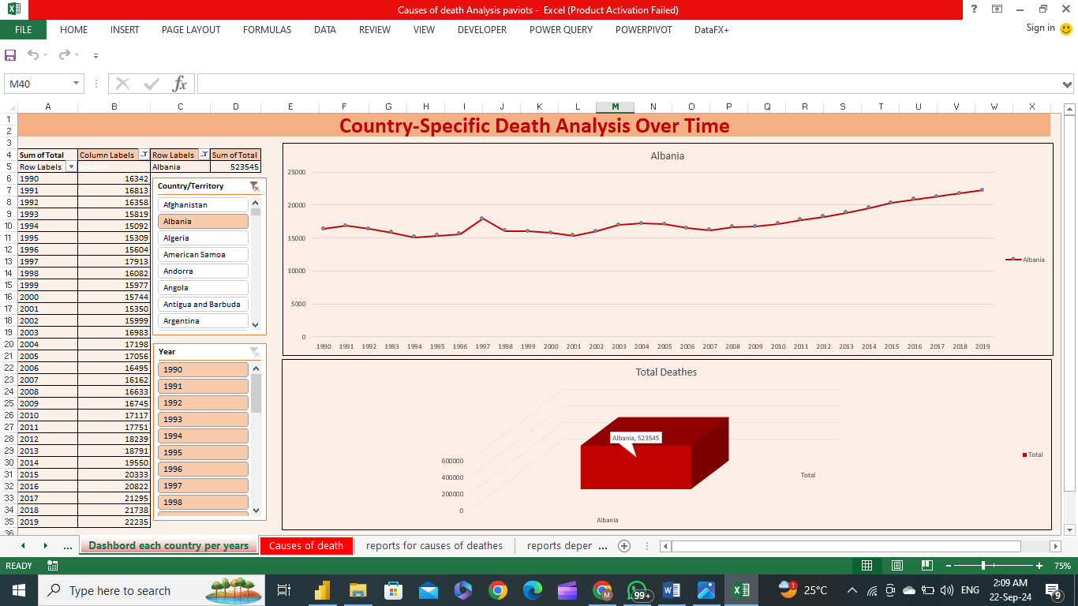

Slide 14
THANK
YOU

